Slide 1
The New Undergraduate Experience Presentation Overview
Purpose of Today’s Presentation
What is NUE and Why It Matters
NUE Structure and Process
A Student Bill of Rights
Preliminary Recommendations
Admissions and Transfer
The Curriculum
Faculty and Pedagogy
The Co-Curriculum and Student Support
Discussion

Slide 2
Purpose of Today’s Presentation
Overview of NUE as Vision Document
Presentation of Preliminary Recommendations for AAC feedback
Feedback will be incorporated into June 23rd Retreat
Final Report and Recommendations will be Presented to full Board in October

Slide 3
NUE’s Foundational Principles
Massachusetts public higher education institutions educate adults, parents, workers, part-time students, transfers, career-changers, certificate students, and stop-outs. Our students are first-generation, low-income, LGBTQIA+, English language learners, and racially, religiously, and neurologically diverse. These intersectionalities of race, class, gender, disability, sexuality, nationality, place of origin, and religion profoundly shape how students engage with higher education and should be thought of as assets they bring with them to enrich our institutions.
The fundamental premise of the New Undergraduate Experience is that the mission of public higher education as an engine of socio-economic mobility and critically engaged citizenship, must be realized through a commitment to advancing racial equity and justice in higher education. Central to the project of advancing racial equity is a relentless belief in the strengths, assets, and cultural wealth of all our students, as well as a recognition that our academic structures, policies and practices have functioned as barriers to student success.
NUE’s recommendations therefore focus on building the capacity of staff and faculty to recognize the assets our students bring with them and to facilitate their learning and success, and on redesigning our institutions, systems, and structures rather than remediating students.
NUE aspires to be bold, visionary and transformative.

Slide 4
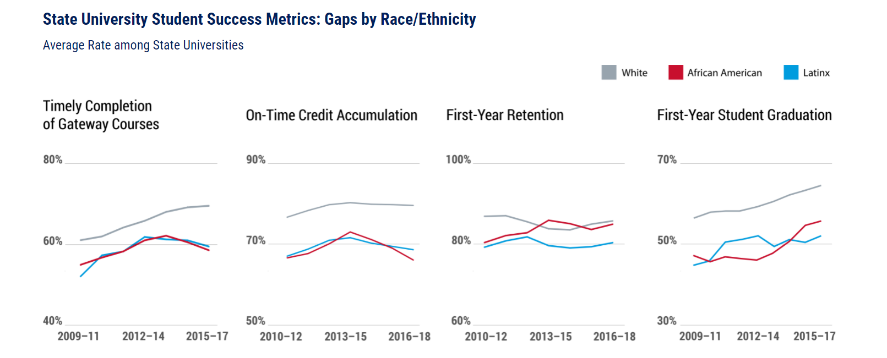
Our data show that while overall completion rates are improving, the equity gap is widening
Source: MA DHE Data Center

Slide 5
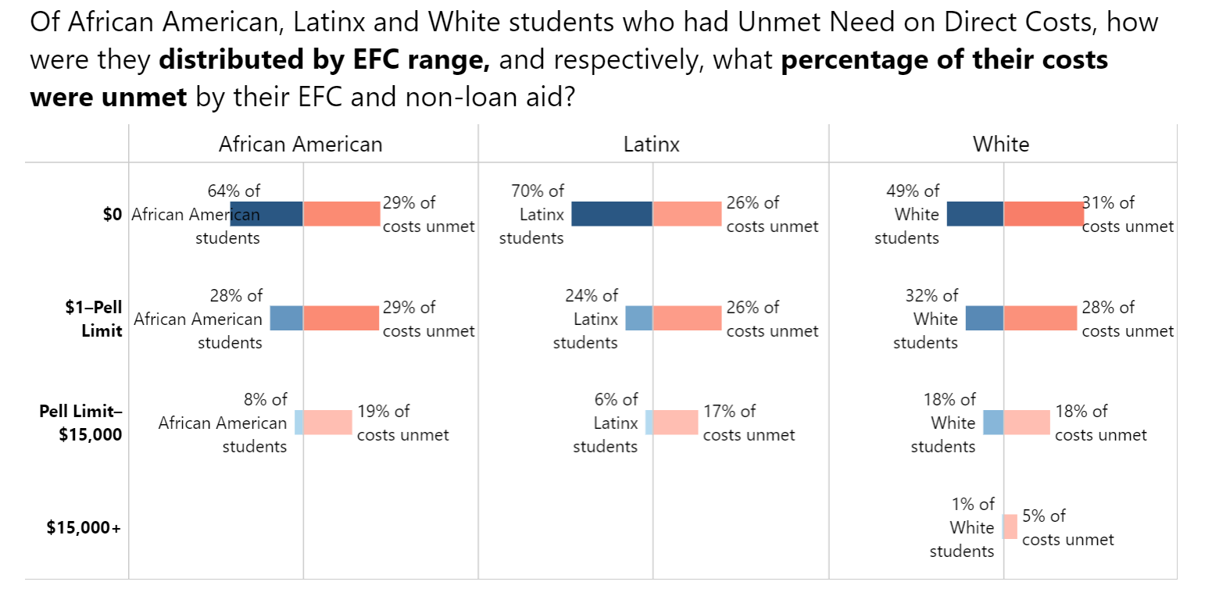
The blue bars demonstrate that students of color with unmet need are more likely to be found in the lower Expected Family Income (EFC) ranges than white students
Source: MA DHE Data Center

Slide 6
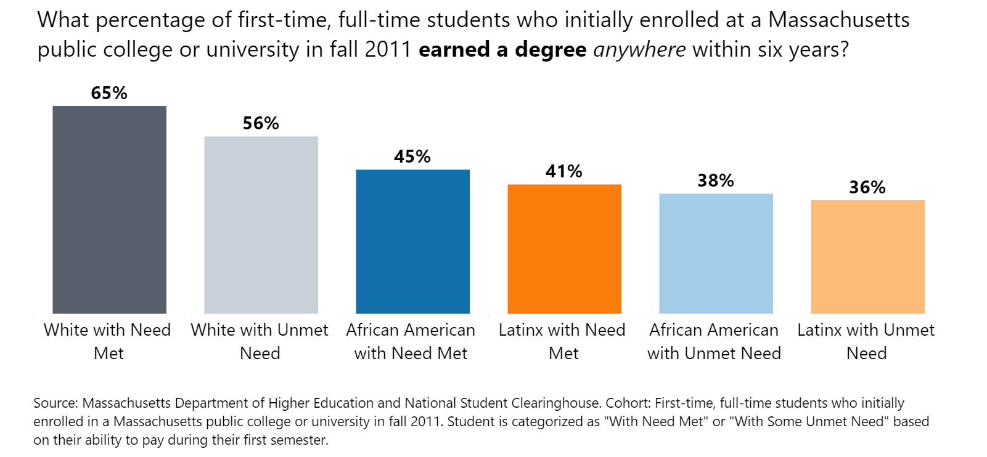
But inequitable outcomes are not attributable to socio-economic status alone. Controlled for SES, students of color still have inequitable access and outcomes.

Slide 7
NUE is an Integral Part of the DHE’s Equity Action Plan
Policy & Program Equity Audit
Re-Imagine the Student Experience Through NUE
Launch the DHE Strategic Planning Process
Expand Data Dashboard

Slide 8
NUE Builds on Existing DHE Equity Efforts, and Ensures Others Adopt an Equity Focus
NUE
Civic Learning & Engagement Policy
CDEP and Early College
MassTeach & STEM Starter
Basic Needs Security Advisory Committee
Dev Ed Reform & Mass-Transfer
Test-Optional Admissions Pilot
OER & Equity-Minded Assessment (AMCOA)
CPL/PLA Consortium

Slide 9
Committees and Structure
Steering Committee
Co-Chairs: Patty Eppinger and Dr. Constanza Cabello
Teaching and Learning Committee
Tri-Chairs: Dr. Paul Hernandez, Cynthia Lynch, and Dimitri Moore
Student-Ready Institutions Committee
Tri-Chairs: Dr. Deanna Yameen, Marquis Taylor, and Dezary Guzman
Faculty, Curriculum and Pedagogy
Professional Development and Assessment
Foundational Elements
Institutional Culture
Transitions
Holistic Student Supports

Slide 10
Stakeholders and Process
Broadly inclusive membership of 60+ people representing all 29 institutions, from Presidents and Chancellors to executive leadership, administrators, staff, faculty and students, and external partners such as employers, advocacy organizations, the K-12 sector, and the AAC&U
Monthly Committee Meetings
Weekly/ Biweekly Working Group Meetings
6 Student Focus Groups with Students from NUE and SAC
Three All-Committee Joint Meetings
One All-Committee Retreat (upcoming)

Slide 11
Key Themes from Student Focus Groups
What Our Students Want:
Additional Support at Important Moments of Transition
To See Their Identities Reflected and Valued in the Curriculum and on the Campus
To Be Represented in Student Government and to Have a Voice in Decisions that Affect Them
For Institutions to be Transparent and Accountable in Implementing the Equity Agenda

Slide 12
A Student Bill of Rights
Students Have The Right To:
Clear, accessible, and understandable financial information, and affordable and predictable education costs
Welcoming, inclusive, and safe campus environments
Equitable access to experiential learning opportunities, in and out of the classroom
Inclusive, anti-racist, and culturally responsive curricula and pedagogies
Diverse and supportive faculty and staff who are equity-minded higher education practitioners
Timely and relevant pathways to graduation and employment
A voice in the decisions that impact their education
But to fulfill these promises to all our students, we must focus on racial equity

Slide 13
Cross-Cutting Recommendations
The Equity Agenda will be the guiding paradigm for the curricular and co-curricular undergraduate experience
The access, success, retention, persistence and graduation of our Black, Latinx, Asian, Indigenous and other students of color will be prioritized
Data must be both disaggregated and intersectional
Equity-based policy and program audits will be regularly implemented by institutions and system
All trustees, executives, faculty, and staff will participate in racial educational equity professional development
Accountability structures will be created to ensure that racial equity and justice progress is being made

Slide 14
Admissions & Transfer
Race-neutral admissions policies have resulted in greater under-representation of students of color at our 4-year institutions
Source: Education Trust’s State Equity Audit

Slide 15
Admissions & Transfer
Goals
Replace race-neutral admissions policies that have been shown to advantage white students with race-conscious admissions policies and practices
Eliminate barriers in application and enrollment for students of color and for populations of students where students of color are over-represented
Achieve racial equity in enrollment and transfer, so that student diversity reflects the diversity of local and state populations.
Key Preliminary Recommendations
Examine admissions practices through a racial equity lens
Institutions will be required to use the Massachusetts Articulated System of Transfer (MAST) common course numbering system
Develop system that will automatically contact qualifying transfer students to complete the ReverseTransfer/FERPA release form when eligible for the associate degree.
Develop “opt-out” admissions policies
Develop a statewide dual admission program
.

Slide 16
Developmental Education, English Language Learners (ELL), & Credit for Prior Learning (CPL)
Developmental Education is a Barrier to Student Success
Source: MA DHE Enrollment and Completion Data

Slide 17
Developmental Education, English Language Learners (ELL), & Credit for Prior Learning (CPL)
Goals
Eliminate barriers for students of color to enroll in credit-bearing coursework
Replace deficit and remediation models with asset and strengths-based approaches that recognize student cultural wealth
Key Preliminary Recommendations
Reconvene and charge statewide Developmental Education Advisory Board with phasing out non-credit Developmental Education
Create and charge a DHE-led state-wide ELL working group with redesigning and aligning ELL programs
Strengthen Prior Learning Assessment (PLA or CPL) consortium by including 4-year Institutions
Create transfer agreement and partnership among all 4-year institutions to recognize Credit for Prior Learning awarded by community colleges

Slide 18

A Rejuvenated Core Curriculum
“In a society marked by deep and persistent disparities based on race, ethnicity, and socioeconomic status, LIBERAL EDUCATION OFFERS THE BEST MEANS TO THE DEMOCRATIC END OF UNIVERSAL ACCESS TO OPPORTUNITY AND TO FULFILL THE PROMISE OF SOCIAL MOBILITY. Put simply, if the learning outcomes of a liberal education correspond to the proficiencies required for engaged citizenship and for success in the workplaces of today and tomorrow—and educators and employers alike agree that they do —then liberal education can unleash the potential of those otherwise most likely to be excluded from full participation in civic and economic life.”
Association of American Colleges and Universities, “What Liberal Education Looks Like: What It Is, Who It’s For, and Where It Happens” (2020)

Slide 19
A Rejuvenated Core Curriculum
Goals:
A system-wide Core framework that is student-centered, culturally relevant, and learning outcomes-driven, with racial justice, equity, and recognition of student cultural wealth as foundational principles
Key Preliminary Recommendations
Replace “General Education” terminology with “Core Curriculum”
Replace “diversity” or “multicultural” Gen Ed requirements with a racial equity and justice Institutional Learning Outcome
Create and charge a broadly inclusive working group with the examination and re-design of the Core

Slide 20
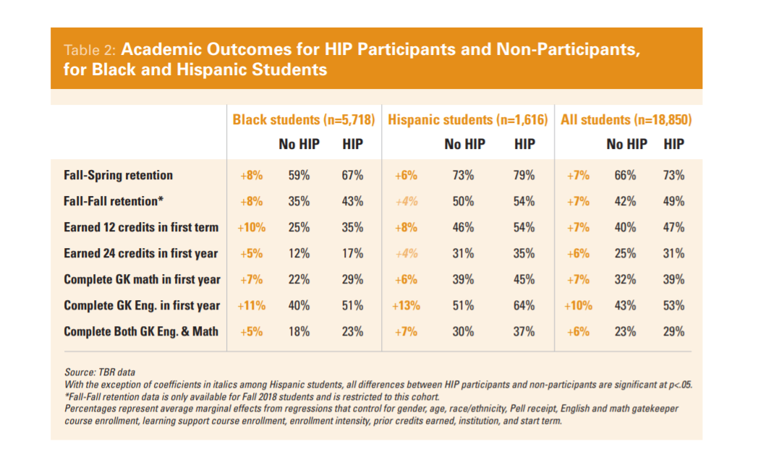
High-Impact Practices & the Co-Curriculum
High Impact Practices (HIPs) are Effective in Improving Outcomes for Black and Latinx Students and Closing Equity Gaps
Source: Tennessee Board of Regents and the Lumina Foundation,
February 2021

Slide 21
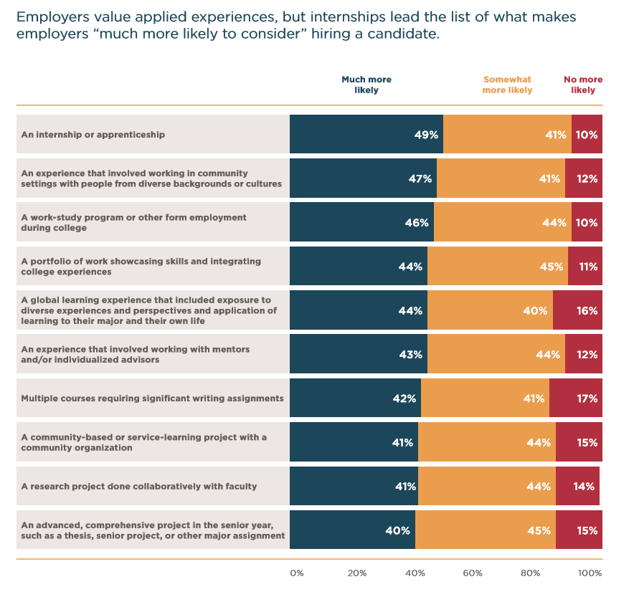
High-Impact Practices & the Co-Curriculum
HIPs Make College Graduates More Attractive to Employers
Source:
Ashley Finley, “How College Contributes to Workforce Success: Employer Views on What Matters Most” (AAC&U, 2021)

Slide 22
High-Impact Practices & the Co-Curriculum
Goals
Recognition that HIPs and co-curricular learning (“experiential learning”) are essential to both liberal arts and professional education and are effective in closing equity gaps and ensuring graduate employment
Achieve racial equity in student participation and successful outcomes in experiential learning opportunities
Implementation of co-curricular learning outcomes, including awareness of and competence in racial justice and equity.
Key Preliminary Recommendations
Create visible mentoring networks of faculty, staff, alumni, and employers of color
Identify and eliminate barriers to high-impact/co-curricular experiences and prioritize participation and success of all students of color
Create system-wide community of practice that includes employers as well as higher education practitioners

Slide 23
Hiring, Supporting & Retaining Faculty & Staff of Color
The Diversity of Our Students Is Not Reflected in the Diversity of Our Faculty
Source: MA DHE Student Enrollment and Employee Date

Slide 24
Hiring, Supporting
& Retaining Faculty & Staff of Color
Goals
A highly diverse faculty and staff at our public institutions that reflect the diversity and identities of our students
Key Preliminary Recommendations
Each campus will have a CDO with sufficient resources
Implement hiring, tenure, and promotion processes that prioritize racial equity and equity-mindedness
Institutional cultures that acknowledge, recognize and reward the invisible labor of faculty and staff of color
Institute a DHE-supported, system-wide commitment to developing students of color to be the faculty of the future

Slide 25
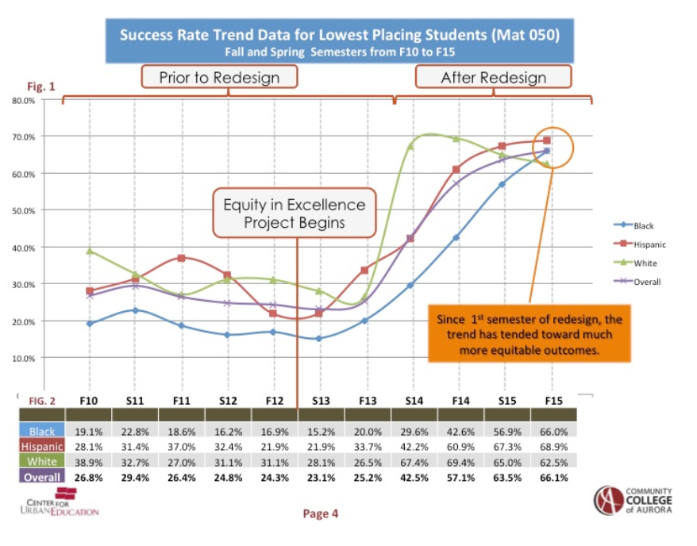
Equity-Minded Teaching, Learning & Assessment & Professional Development For Faculty & Staff
Professional Development Works: When Faculty Re-Design Their Courses and Pedagogies, Equity Gaps Close and All Students Benefit
Source:
“CUE’s Impact on Equity Gaps“ (https://cue.usc.edu/about/equity/impact/)

Slide 26
Equity-Minded Teaching, Learning & Assessment
&
Professional Development for Faculty and Staff
Goals
Teaching and learning experiences that are student-centered, affirm students’ cultures and identities, cultivate critical consciousness of race, gender, and intersectional identities, maintain high expectations for academic success and teaching excellence, and utilize low-cost and no-cost classroom materials (OER)
Race-conscious, holistic, qualitative as well as quantitative assessment of student learning, featuring disaggregated data by race and gender as well as intersectional factors such as first-generation status and age
Key Preliminary Recommendations
Enhance and scale up DHE-supported, system-wide platforms for collaborative professional development
Institutional commitment to resources for equity-minded assessment, including support and PD for faculty-led learning outcomes assessment as well as resources for Institutional Research Offices
A faculty and staff adept in culturally responsive/sustaining, trauma-informed practices and pedagogies and universal design (UD), committed to designing curricula that reflect the diversity of student experiences and identities, aware of the histories of racial inequity and injustice that have shaped higher education and our society generally, and committed to using data and assessment to improve practices

Slide 27
Curricular and Co-Curricular Advising
& Support
Race-Neutral Academic Policies Have Inequitable Effects
Source: Internal data provided by MA Community College for HEIF Grant

Slide 28
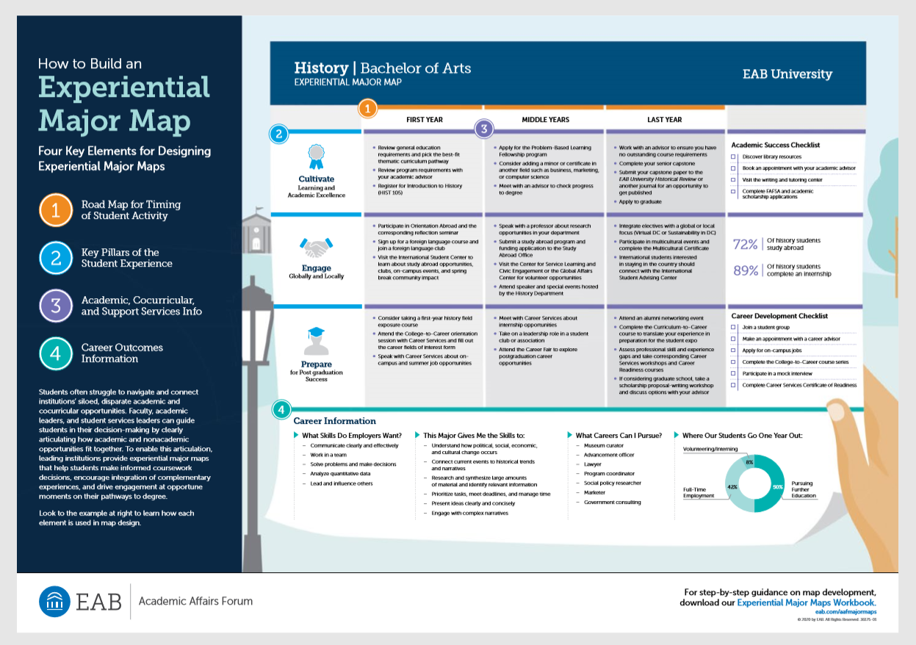
Curricular and Co-Curricular Advising
& Support
Integrating Career & Academic Advising Gives Students Clear & Relevant Pathways to Graduation & Employment

Slide 29
Curricular and Co-Curricular Advising
& Support
Goals
Implementation of equitable and just policies concerning academic progress, leave, withdrawal and readmission
Key Preliminary Recommendations
Examine campus and system discipline, financial, probation, leave (including medical leave), withdrawal, and readmissions policies through an equity lens
Implement flexible and accelerated semesters and scheduling to give students multiple on-ramps back into learning
Ensure and prioritize equitable access to career development and networking capital for students of color and populations among whom students of color are over-represented (first gen, e.g.)
Integration of co-curricular career advising and curricular academic advising throughout entire undergraduate experience for all students, and especially students of color

Slide 30
Mental Health,
Safety & Wellness
“We are told to pursue higher education and go to college, but colleges are not ready for us as students of color.”
--NUE Student Member
Source: https://www.jedfoundation.org/steve-fund-jed-launch-equity-mental-health-framework-support-college-students-color

Slide 31
Mental Health,
Safety & Wellness
Goals
A proactive, predictive, assets-based, equity-centered, “No Wrong Door” culture of dignity, respect​, safety, compassion and care
Key Preliminary Recommendations
Seamless, wraparound support that ensures access and integrates academic and career advising with academic support, mental health, safety and wellness, housing and food security, digital access, and restorative justice
Review and revise campus policing practices to address racial trauma, center wellness and mental health awareness, and incorporate restorative justice practices
Explore partnerships with community agencies and other providers to amplify mental health support designed for students of color
Support the recommendations of the Basic Needs Security Advisory Committee

Slide 32
Discussion
What Needs more Evidence?
What is unclear?
What is missing?
What Resonates With You?

